Slide 1
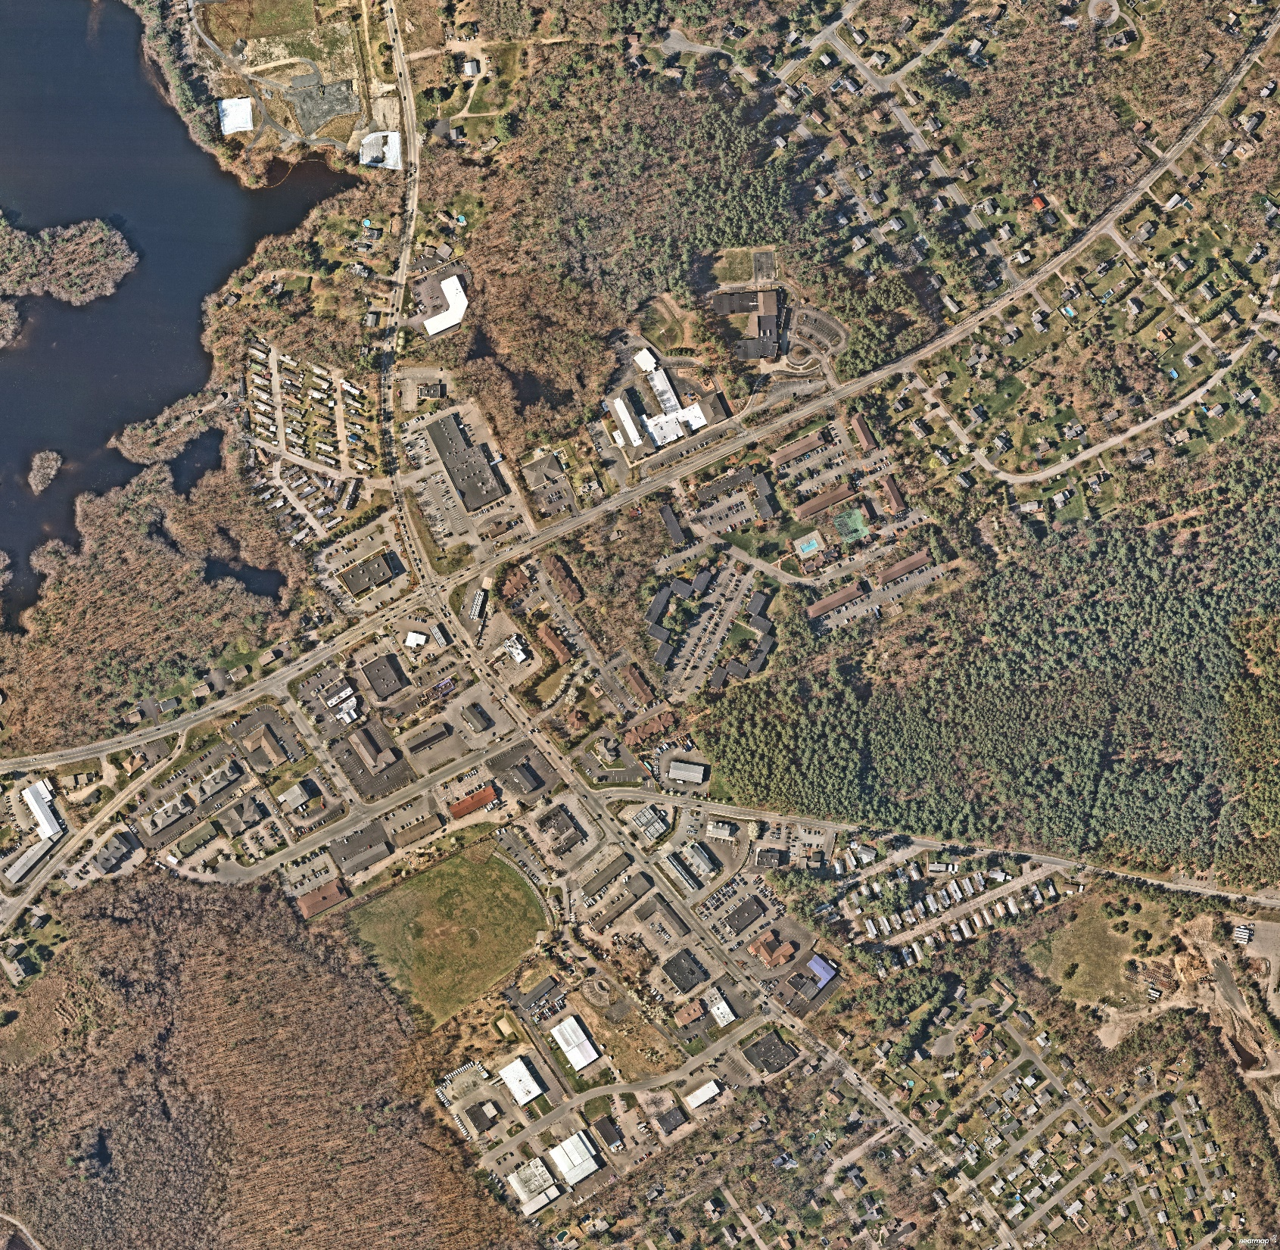

Route 106 & Route 152
Corridor Improvements
Pre-25% Design
(Plainville & North Attleborough)
November 25, 2024
Plainville
Select Board
Imagery Source: Nearmap Imagery Date: April 2024

Slide 2


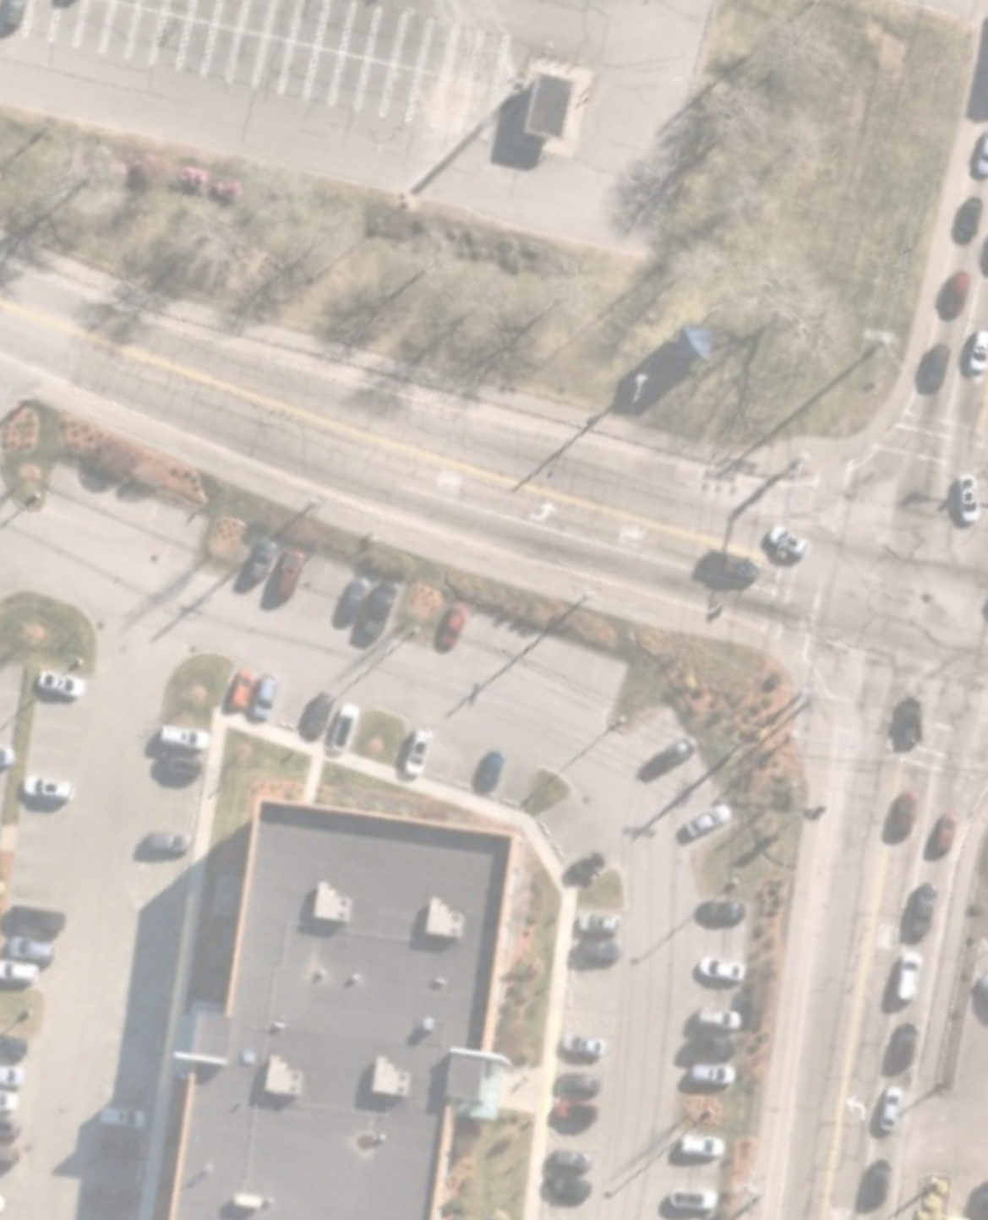
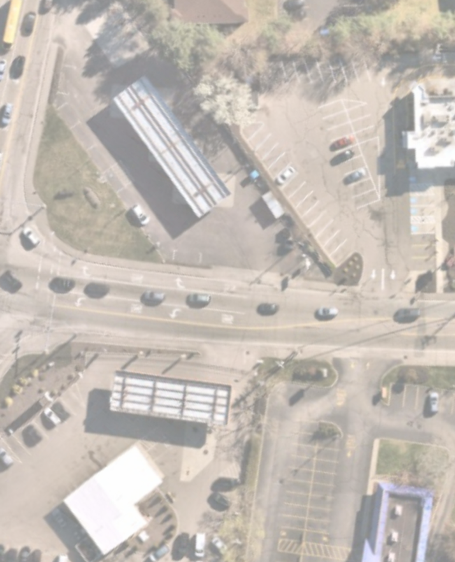




















Slide 3
Follow-Up Crash History with Plainville Police Data
Taunton Street (Route 152) at Messenger Street (Route 106)
371 crashes occurred between 2013 and 2023
Many crashes took place at nearby driveways
56 (21%) resulted in injuries
155 (42%) were Angle Type Collisions
134 (36%) were Rear-End Type Collisions
Crash Rate – 2.57
Average Crash Rate for Signalized Intersections
Statewide 0.78
District 5 0.75

Slide 4
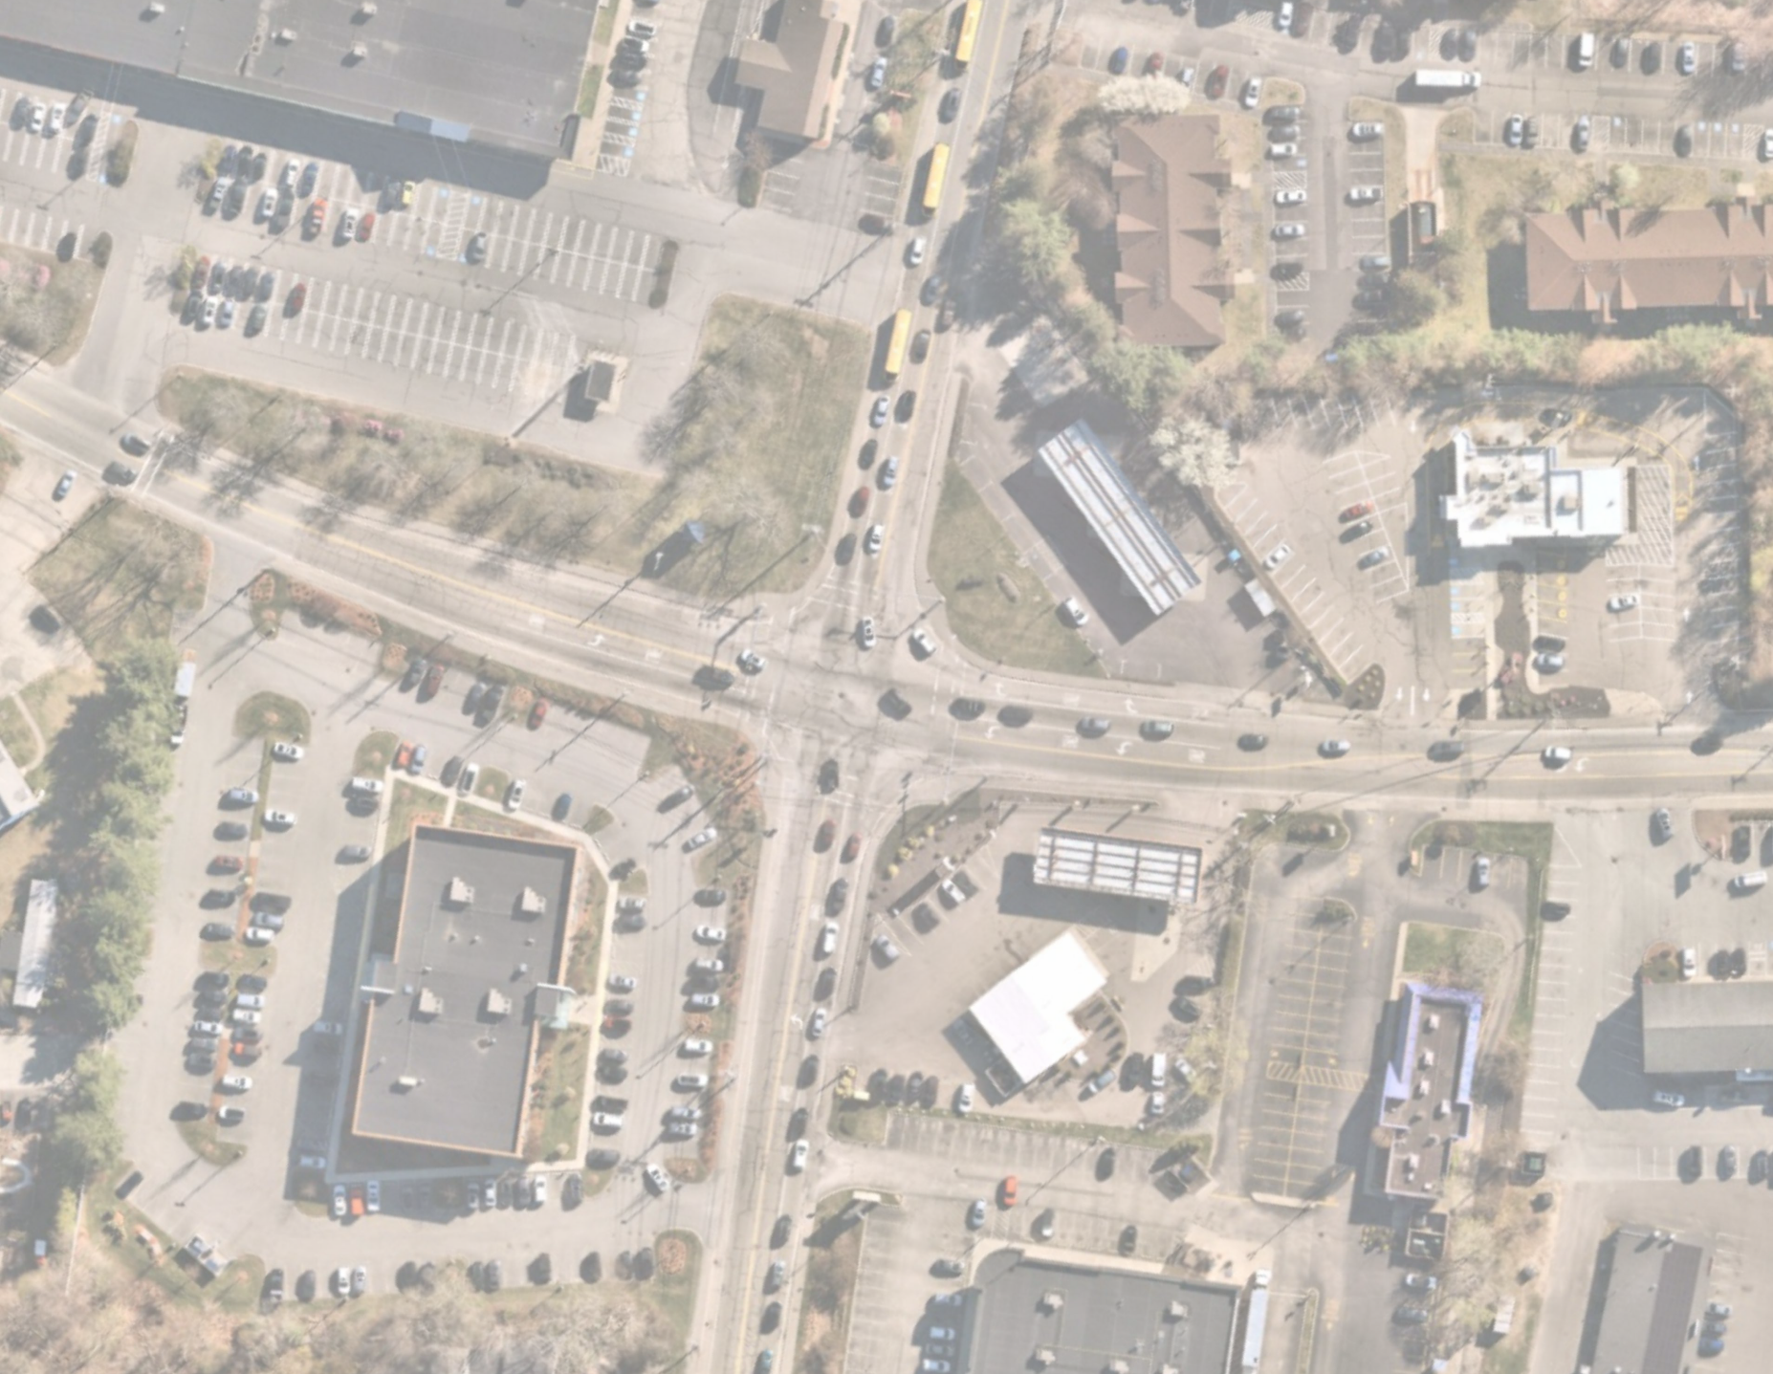


Slide 5
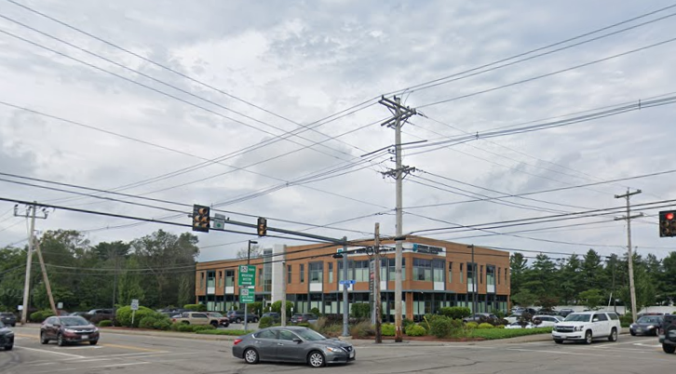
Existing Condition: Utility Pole Considerations
Approximate cost to move utility pole could be upwards of $500k, as this is a major junction for intersecting large transmission power lines. The effects of moving one pole effects all poles in each direction.
The relocation of one major pole will trigger additional Right of Way costs in all four directions of the intersection
Imagery Source: Google Street View Imagery Date: April 2024

Slide 6
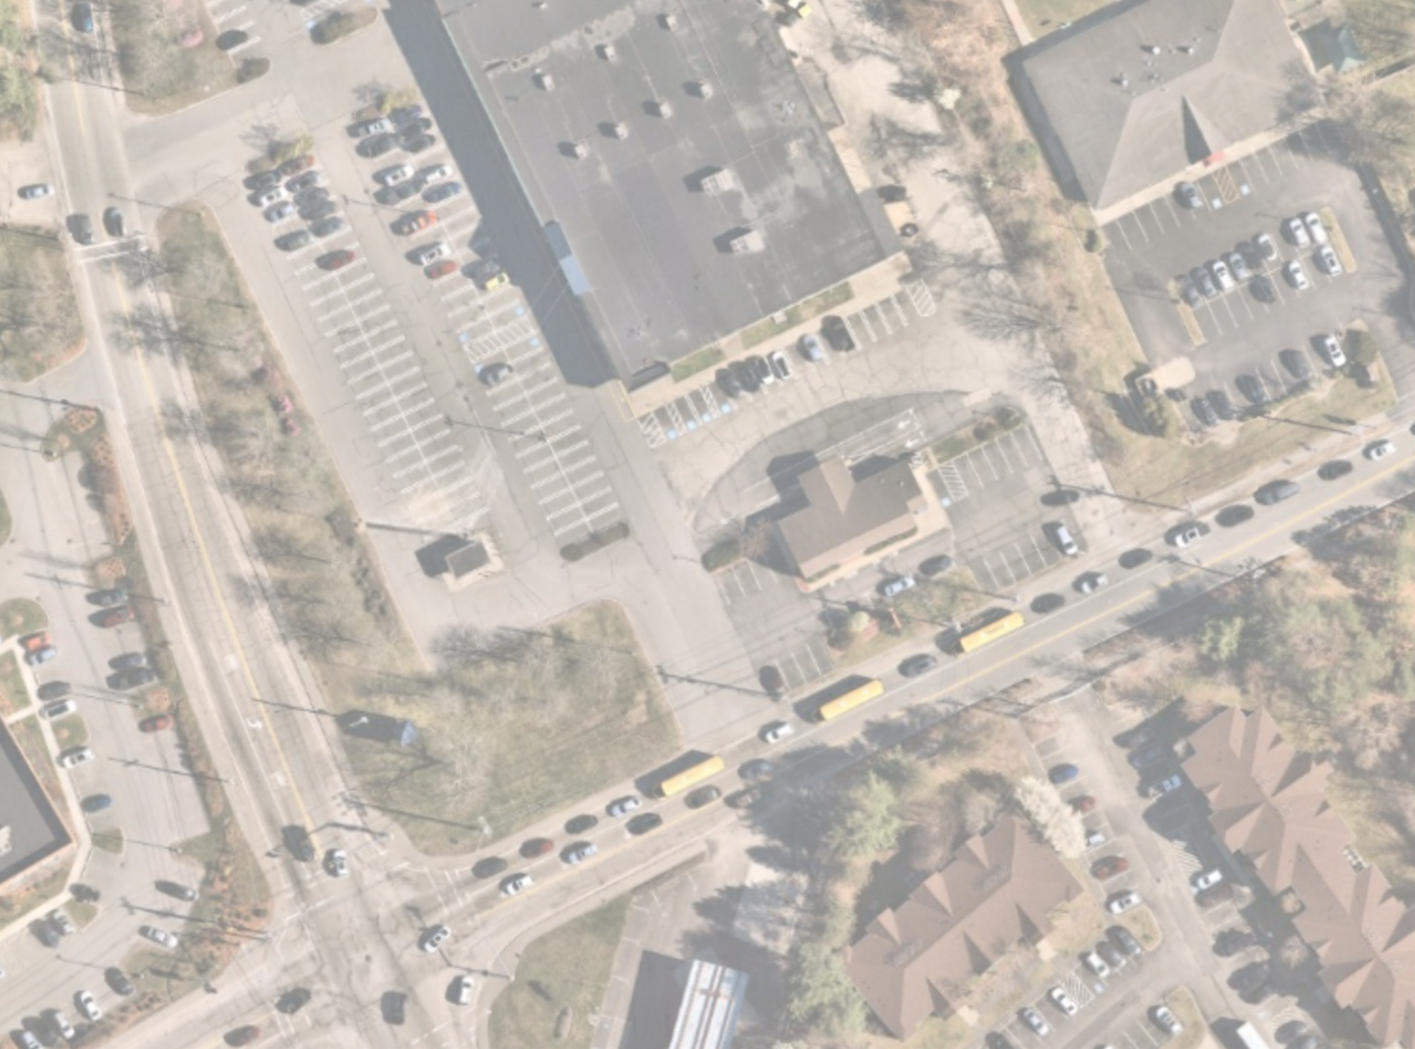








Slide 7
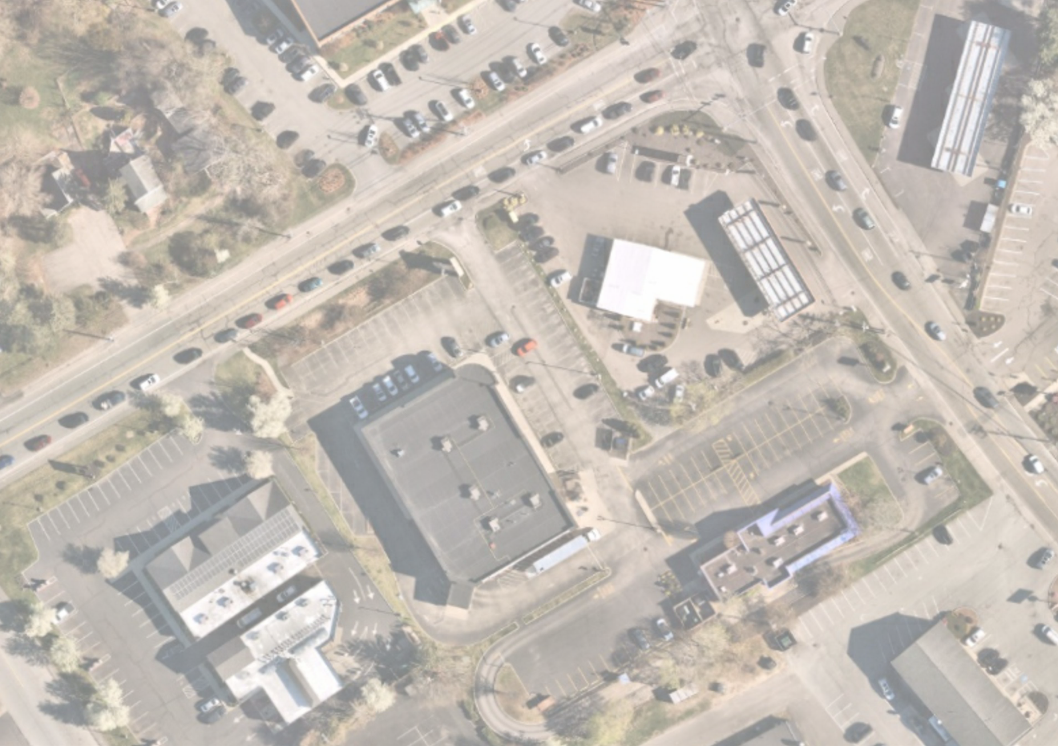




Slide 8
Next Steps
Continue discussion with affect property owners; already initiated outreach to property owners at 64 Messenger St and 2 Wilkins Drive
Advance Pre-25% Design to 25% Design Submittal
Execute Contract for Final Design (25% through Advertisement) with North Attleborough

Slide 9
Thank You!
Bill O’Rourke
Director of Plainville Public Works
Mike Mullen
Director of Plainville Planning & Economic Development
190 South St, PO Box 1717,
Plainville, MA 02762
p. 508-695-3010

